Slide 1
File I/O
Chapter 9 and 19

Slide 2
The File Class
The File class is intended to provide an abstraction that deals with most of the machine-dependent complexities of files and path names in a machine-independent fashion. The filename is a string. The File class is a wrapper class for the file name and its directory path.

Slide 3
Obtaining file properties and manipulating file

Slide 4
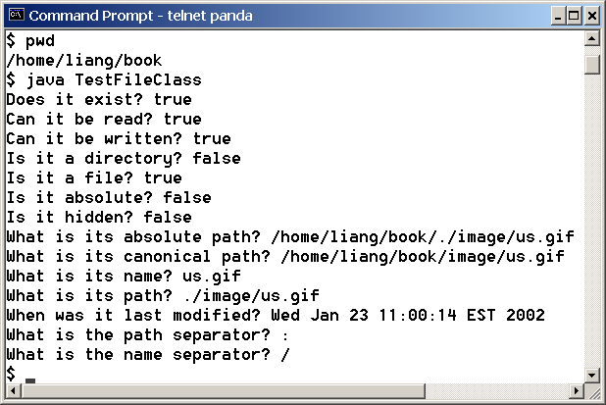
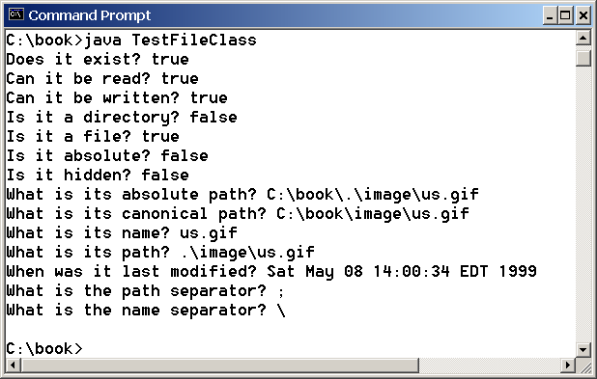
Problem: Explore File Properties
Objective: Write a program that demonstrates how to create files in a platform-independent way and use the methods in the File class to obtain their properties. Figure 16.1 shows a sample run of the program on Windows, and Figure 16.2 a sample run on Unix.
TestFileClass
Run

Slide 5
Text I/O
A File object encapsulates the properties of a file or a path, but does not contain the methods for reading/writing data from/to a file. In order to perform I/O, you need to create objects using appropriate Java I/O classes. The objects contain the methods for reading/writing data from/to a file. This section introduces how to read/write strings and numeric values from/to a text file using the Scanner and PrintWriter classes.

Slide 6
Writing Data Using PrintWriter
WriteData
Run

Slide 7
Reading Data Using Scanner
ReadData
Run

Slide 8
How is I/O Handled in Java?
A File object encapsulates the properties of a file or a path, but does not contain the methods for reading/writing data from/to a file. In order to perform I/O, you need to create objects using appropriate Java I/O classes.
Scanner input = new Scanner(new File("temp.txt"));
System.out.println(input.nextLine());
PrintWriter output = new PrintWriter("temp.txt");
output.println("Java 101");
output.close();

Slide 9
Text File vs. Binary File
Data stored in a text file are represented in human-readable form. Data stored in a binary file are represented in binary form. You cannot read binary files. Binary files are designed to be read by programs. For example, the Java source programs are stored in text files and can be read by a text editor, but the Java classes are stored in binary files and are read by the JVM. The advantage of binary files is that they are more efficient to process than text files.
Although it is not technically precise and correct, you can imagine that a text file consists of a sequence of characters and a binary file consists of a sequence of bits. For example, the decimal integer 199 is stored as the sequence of three characters: '1', '9', '9' in a text file and the same integer is stored as a byte-type value C7 in a binary file, because decimal 199 equals to hex C7.

Slide 10
Binary I/O
Text I/O requires encoding and decoding. The JVM converts a Unicode to a file specific encoding when writing a character and coverts a file specific encoding to a Unicode when reading a character. Binary I/O does not require conversions. When you write a byte to a file, the original byte is copied into the file. When you read a byte from a file, the exact byte in the file is returned.

Slide 11
Binary I/O Classes

Slide 12
InputStream
The value returned is a byte as an int type.

Slide 13
OutputStream
The value is a byte as an int type.

Slide 14
FileInputStream/FileOutputStream
FileInputStream/FileOutputStream associates a binary input/output stream with an external file. All the methods in FileInputStream/FileOuptputStream are inherited from its superclasses.

Slide 15
FileInputStream
To construct a FileInputStream, use the following constructors:
public FileInputStream(String filename)
public FileInputStream(File file)
A java.io.FileNotFoundException would occur if you attempt to create a FileInputStream with a nonexistent file.

Slide 16
FileOutputStream
To construct a FileOutputStream, use the following constructors:
public FileOutputStream(String filename)
public FileOutputStream(File file)
public FileOutputStream(String filename, boolean append)
public FileOutputStream(File file, boolean append)
If the file does not exist, a new file would be created. If the file already exists, the first two constructors would delete the current contents in the file. To retain the current content and append new data into the file, use the last two constructors by passing true to the append parameter.
TestFileStream
Run

Slide 17
Random Access Files
All of the streams you have used so far are known as read-only or write-only streams. The external files of these streams are sequential files that cannot be updated without creating a new file. It is often necessary to modify files or to insert new records into files. Java provides the RandomAccessFile class to allow a file to be read from and write to at random locations.

Slide 18
RandomAccessFile

Slide 19
File Pointer
A random access file consists of a sequence of bytes. There is a special marker called file pointer that is positioned at one of these bytes. A read or write operation takes place at the location of the file pointer. When a file is opened, the file pointer sets at the beginning of the file. When you read or write data to the file, the file pointer moves forward to the next data. For example, if you read an int value using readInt(), the JVM reads four bytes from the file pointer and now the file pointer is four bytes ahead of the previous location.

Slide 20
RandomAccessFile Methods
Many methods in RandomAccessFile are the same as those in DataInputStream and DataOutputStream. For example, readInt(), readLong(), writeDouble(), readLine(), writeInt(), and writeLong() can be used in data input stream or data output stream as well as in RandomAccessFile streams.

Slide 21
RandomAccessFile Methods, cont.
void seek(long pos) throws IOException;
Sets the offset from the beginning of the RandomAccessFile stream to where the next read or write occurs.
long getFilePointer() IOException;
Returns the current offset, in bytes, from the beginning of the file to where the next read or write occurs.

Slide 22
RandomAccessFile Constructor
RandomAccessFile raf = new RandomAccessFile("test.dat", "rw"); //allows read and write
RandomAccessFile raf = new RandomAccessFile("test.dat", "r"); //read only

